Slide 1
Decision Tree
Build decision tree on Cleaned Titanic train dataset
ISOM3360
Lab 2

Slide 2
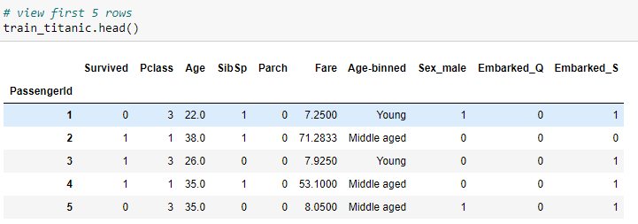
Import useful libraries and load the data
Import useful libraries
Load ‘train_titanic’ dataset
# import library used for data management
import numpy as np
import pandas as pd
Make sure that the ‘train_titanic.csv’ is in the same directory with your working .ipynb file
# load dataset
train_titanic = pd.read_csv(train_titanic.csv',index_col='PassengerId')

Slide 3
Get features and label
Recall the purpose of this Titanic Prediction Project
What are your trying to predict?
The ‘Survived’ value (target variable)
What features/attributes are you going to use to help you doing the prediction?
Pclass, SibSp, Parch, … (features / attributes)
Remember to change Survived to string type
features = [‘Pclass’,‘SibSp’,‘Parch’, ‘Fare’, ‘Age’, ‘Sex_male’, ‘Embarked_S’, ‘Embarked_Q]
target = [‘Survived’]
X = train_titanic[features]
y = train_titanic[target]

Slide 4
Split Data
We will randomly split the train data where the true values of ‘Survived’ for all the passengers are KNOWN into training dataset (60%) and testing dataset (40%)
training dataset is used to train the model, in this case, we will train a decision tree model
testing dataset is for testing purpose, as we know the true value of ‘Survived’ in testing dataset, we can compare the predict value against the true value in order to evaluate how good our model is in terms of accuracy rate
#import functions for data split
from sklearn.model_selection import train_test_split
X_train,X_test, y_train, y_test = train_test_split(X, y, test_size=0.4, random_state = 42)

Slide 5
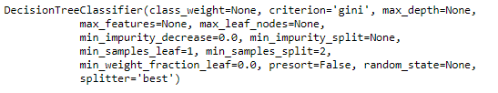
Modeling – Decision Tree
Import ‘Decision Tree Classifier’ from ‘sklearn’
Define model to be decision tree classifier
The model parameters that specified for training
The model parameters shown above are very important in the tuning process and will be discussed in more details later
# DecisionTreeClassifier
from sklearn.tree import DecisionTreeClassifier
model = DecisionTreeClassifier()
# train model
model.fit(X_train, y_train)

Slide 6
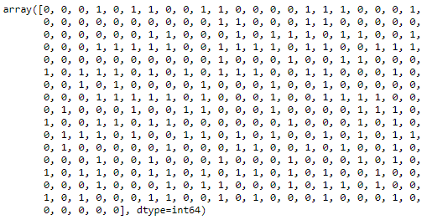
Testing model
We just build the very first tree using the default parameter settings, what would be the predicting result on testing dataset?
# make prediction on 40% test data
pred_test = model.predict(X_test)
pred_test
How it compares to the true value of ‘Survived’?

Slide 7
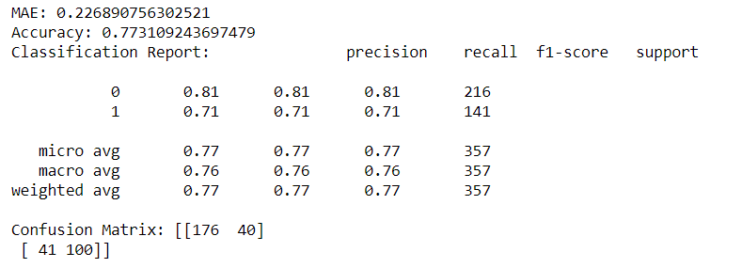
Model accuracy for classification
We will need some evaluation functions from sklearn
Print the evaluation result
from sklearn.metrics import accuracy_score
from sklearn.metrics import classification_report
from sklearn.metrics import confusion_matrix
# evaluate result
print("Accuracy:",accuracy_score(y_test, pred_test, normalize=True, sample_weight=None))
print(“Classification Report:”, ‘\n’,classification_report(y_test, pred_test)) print("Confusion Matrix:", ‘\n’, confusion_matrix(y_test, pred_test))

Slide 8
Get tree structure
Total number of nodes in a tree
Tree features used to split
treeObj = model.tree_
print (treeObj.node_count)
print (treeObj.feature)

Slide 9
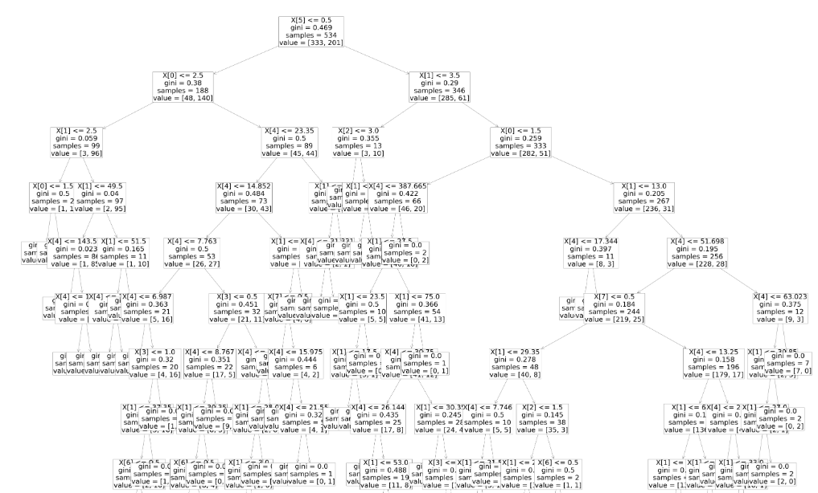
Visualize Tree
Import visualization tools
Show the tree
# import library for visuaiization
from sklearn import tree
import matplotlib.pyplot as plt
plt.figure(figsize = (100,150))
tree.plot_tree(model,ax=None, fontsize=50)
plt.show()

Slide 10
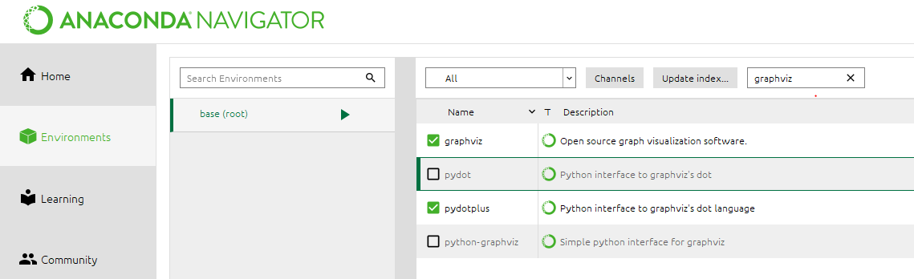
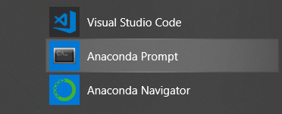
Visualize Tree (optional)
Install new packages of ‘graphviz’ and ‘pydotplus’ in Anaconda
You may need to lunch Anaconda Prompt to do the installation
To install this packages with conda run:
Install graphviz
conda install python-graphviz
conda install anaconda pydotplus

Slide 11
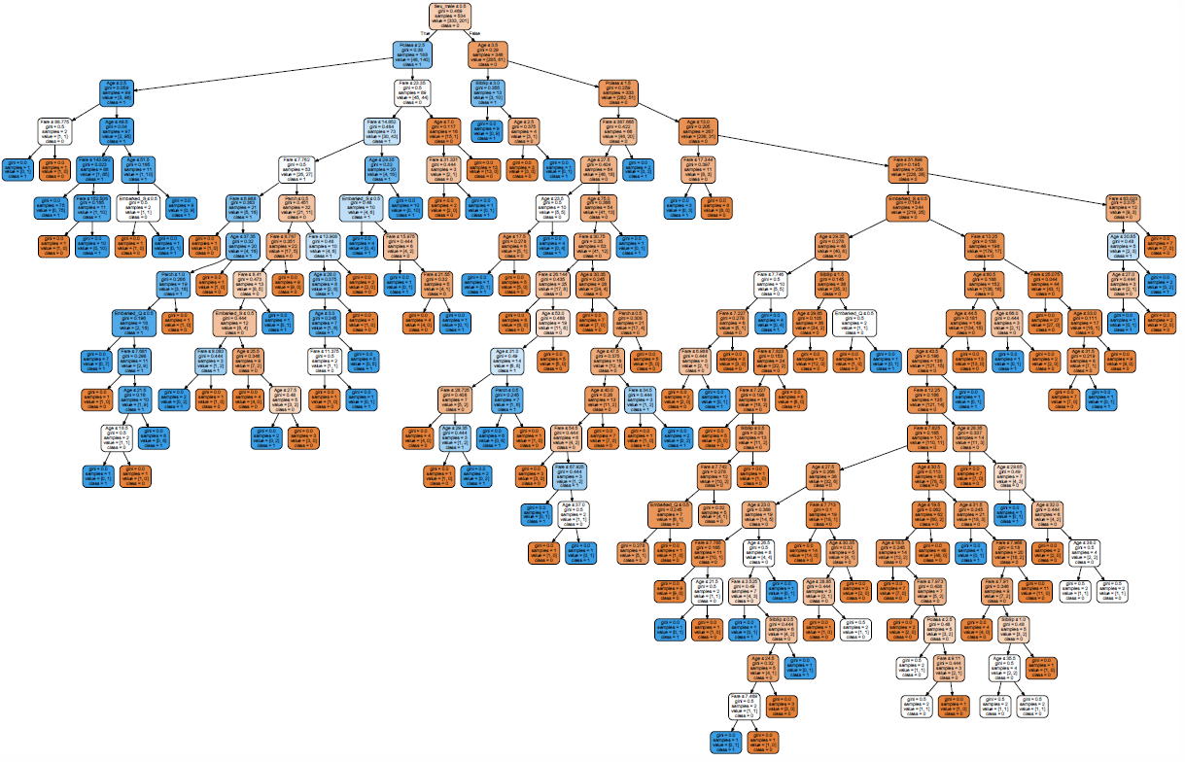
Visualize Tree
Import libraries and functions
Create dot file
Transform dot file to graph
Create a pdf file
# import library for visuaiization
from sklearn.tree import export_graphviz
from IPython.display import Image
import pydotplus
from sklearn import tree
import graphviz
dot_data = tree.export_graphviz(model, out_file=None,
feature_names=features,
class_names=train.Survived.unique(),
filled = True, rounded=True,
special_characters=True)
graph = graphviz.Source(dot_data)
graph
graph.render("titanic_tree")

